Slide 1


PONJESLY COLLEGE OF ENGINEERING
AI-POWERED INTERACTIVE LEARNING AND INTERVIEW PREP PLATFORM
TEAM MEMBERS
SHERJIN A G
SHREJU REMUS B
THARUN M S
JEBIN T

Slide 2


PROBLEM STATEMENT
Lack of unified platforms that blend learning, practice, and preparation
Traditional interview prep lacks interactivity and AI guidance
Students struggle to stay motivated and track progress effectively
Need for gamified, engaging learning with structured career paths

Slide 3
PROJECT OBJECTIVES
Develop an AI-powered interactive platform for learning core computer science concepts and programming languages like Java and Python through gamified modules.
Provide comprehensive interview preparation including AI-driven group discussions, mock interviews, aptitude teaching, and customizable quizzes.
Enhance problem-solving skills with a structured approach covering 400+ data structures and algorithms problems with detailed solutions.
Offer a 12-week career roadmap across five key CS fields featuring curated videos, assignments, and projects for progressive learning.
Build a collaborative community with discussion forums, leaderboards, and an AI chatbot for personalized support and engagement.

Slide 4
ADVANTAGES AND APPLICATIONS
ADVANTAGES
✅ Personalized learning experience powered by AI for better knowledge retention.
✅ Gamification and interactive modules increase engagement and motivation.
✅ Comprehensive interview prep covering aptitude, technical skills, and real-time AI-driven feedback.
✅ Community features foster collaboration and healthy competition.
APPLICATION
🎯Helps job seekers prepare for technical and aptitude interviews confidently.
🎯Enables continuous skill improvement through practice problems and quizzes.
🎯Used by students for effective learning of programming and CS fundamentals.

Slide 5
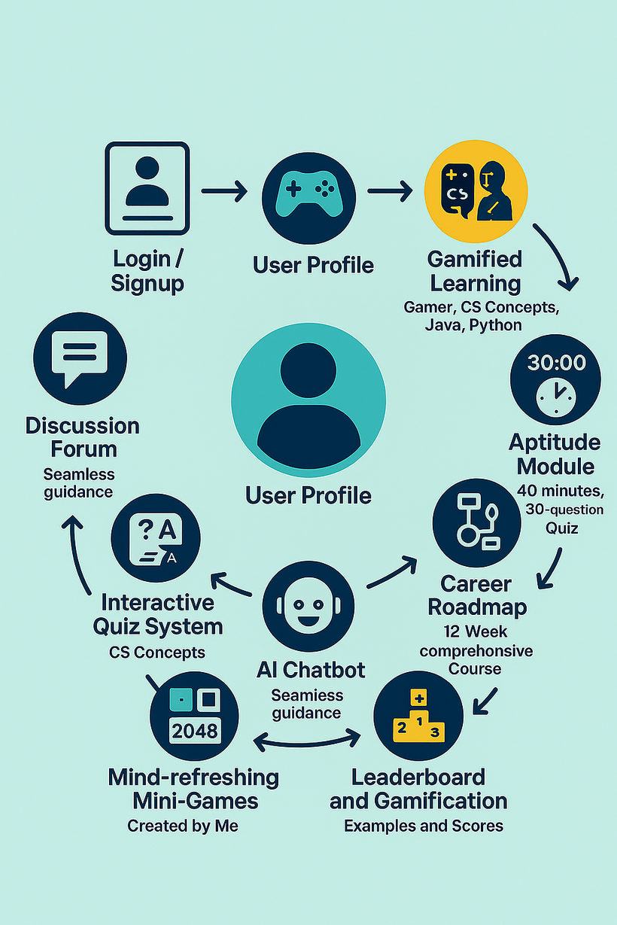

CORE MODULES & INTERACTIONS
🔍Get profile access, and tailored learning recommendations.
🔍Learn Java,and DBMS through interactive quizzes, cards, and streaks.
🔍Practice with an AI interviewer, join group discussions.
🔍Attempt 30-minute quizzes by difficulty and solve 400+ DSA problems with explanations.
🔍Explore 12-week learning paths in AI, Web Dev, App Dev, Data Science, and Cybersecurity.
🔍Refresh your mind with mini-games like 2048 and Tetris integrated into the platform.

Slide 6
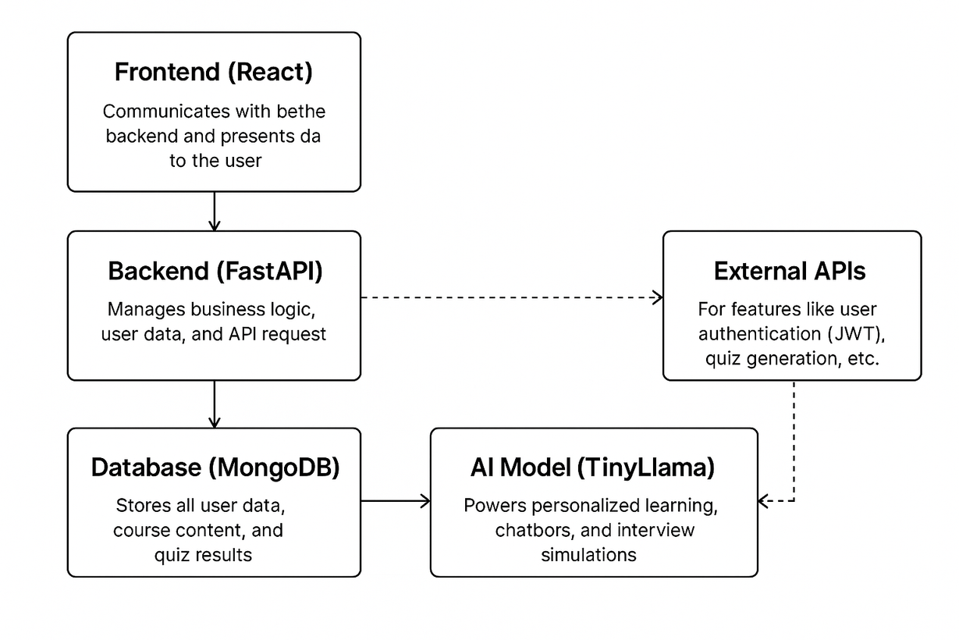
SYSTEM OVERVIEW
The Frontend (React) offers an intuitive interface for learning and quizzes.
The Backend (FastApi) manages user logic, gamification, and AI interactions.
Data is securely stored and retrieved using MongoDB databases.
AI models personalize content, conduct interviews, and enhance learning.

Slide 7
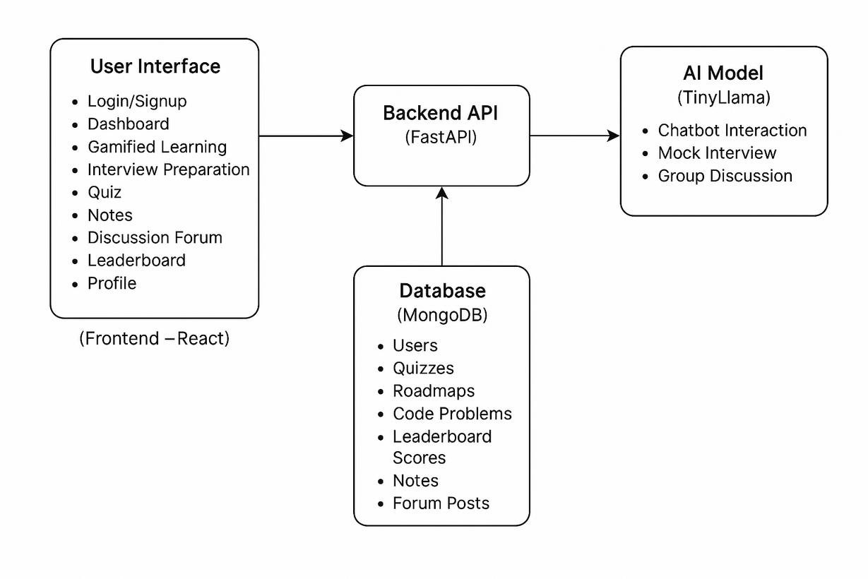
PLATFORM WORKFLOW
⚙️Users sign up or log in, with credentials verified securely on the backend.
⚙️The system fetches user-specific data including profile, progress, and preferences.
⚙️Dashboard dynamically displays personalized learning paths, modules, and quizzes.
⚙️AI-powered tools and real-time updates adapt the experience based on user interactions.

Slide 8
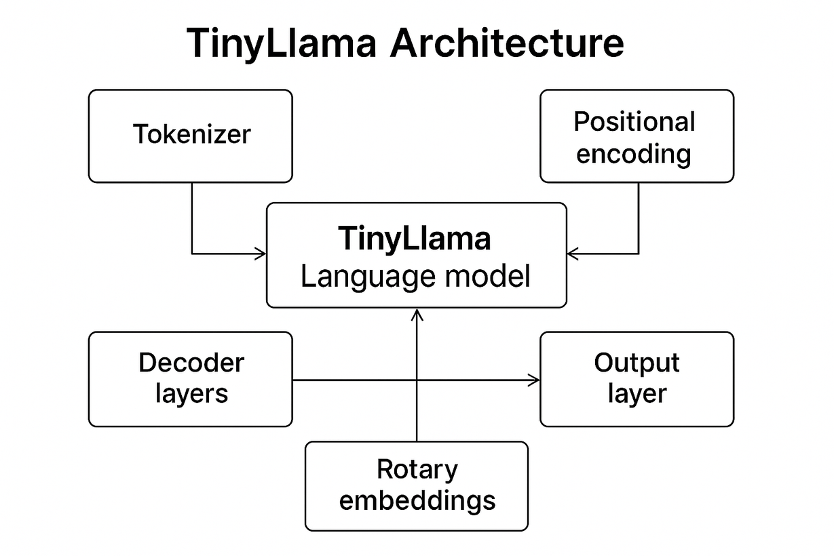
TINYLLAMA MODEL ARCHITECTURE
TOKENIZER – Converts input text into tokens
POSITIONAL ENCODING – Adds sequence order to tokens
ROTARY EMBEDDING – Enhances attention with position rotation
DECODING LAYER – Processes tokens with transformer blocks
OUTPUT LAYER – Generates the next predicted token
LORA TUNING – Lightweight fine-tuning for customization

Slide 9
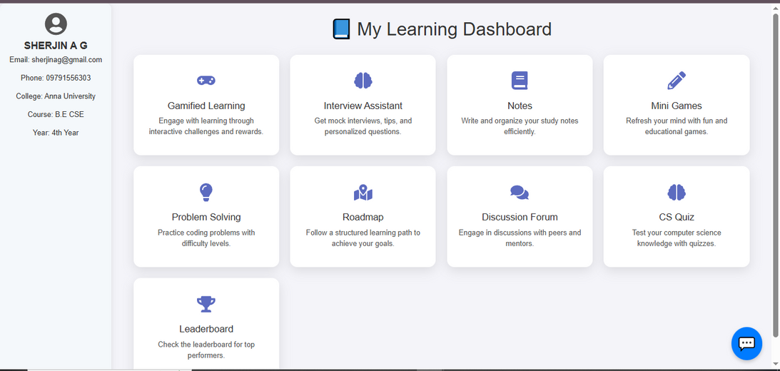
LOGIN AND DASHBOARD
🔑Users start
by signing up or
logging in securely.
🔑Secure data handling
ensures user information
privacy and compliance.
🔑The dashboard presents user
profile details and tracks
learning progress.
🏠Quick access to modules,
quizzes, and mini-games
is available from the dashboard.

Slide 10
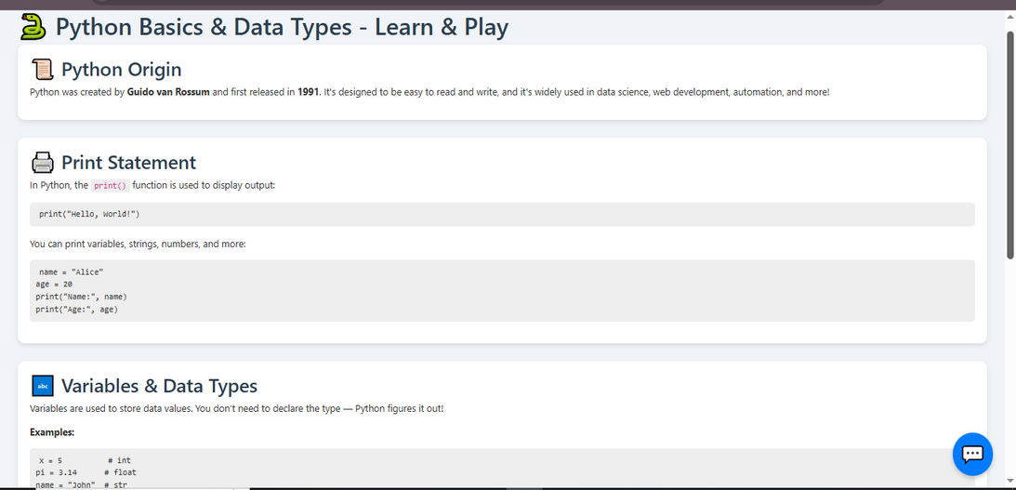
GAMIFIED LEARNING MODULE
🎮 Learn core CS topics like Java, Python, OS, DBMS, and Networks with interactive games.
🎮Mini-games like 2048 and Tetris refresh the mind and boost focus.
🎮Progress through levels with quizzes after each topic to reinforce learning.
🎮Timed quizzes test knowledge with instant feedback for better retention.

Slide 11
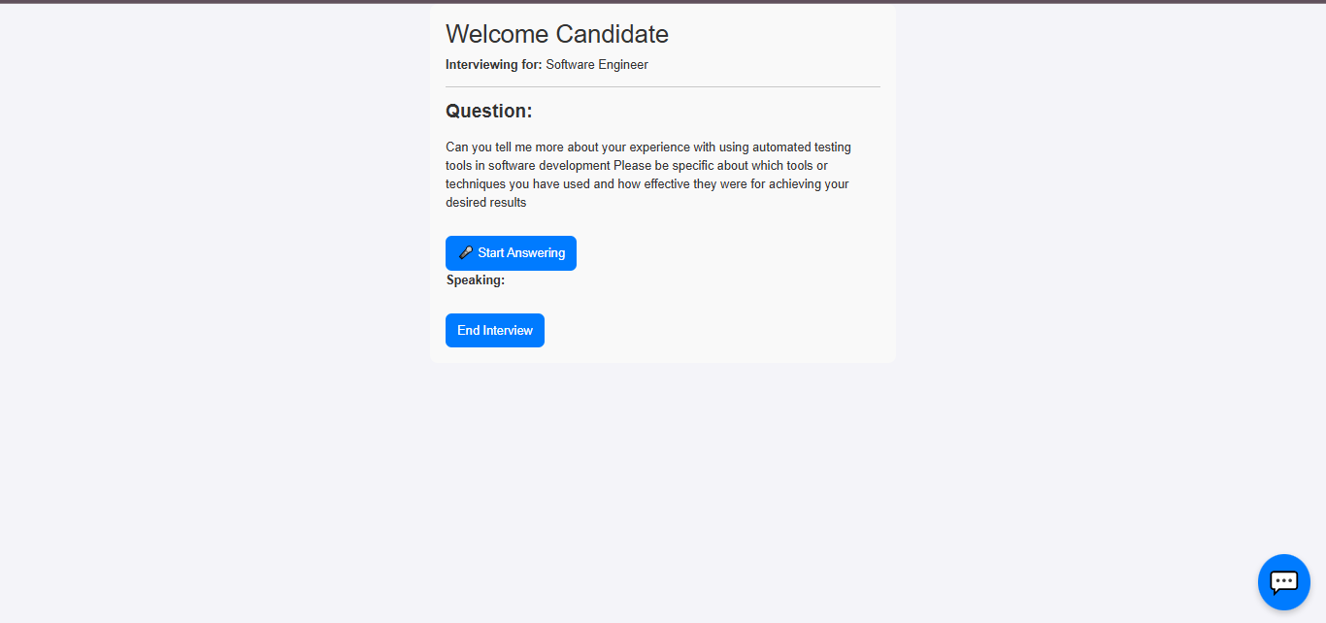
AI-POWERED INTERVIEWER
🎤TinyLlama model generates interview questions dynamically
🎤Frontend uses gTTS to convert questions into speech
🎤User responds via voice input, enabling interactive practice
🎤System processes answers and moves to the next question seamlessly

Slide 12
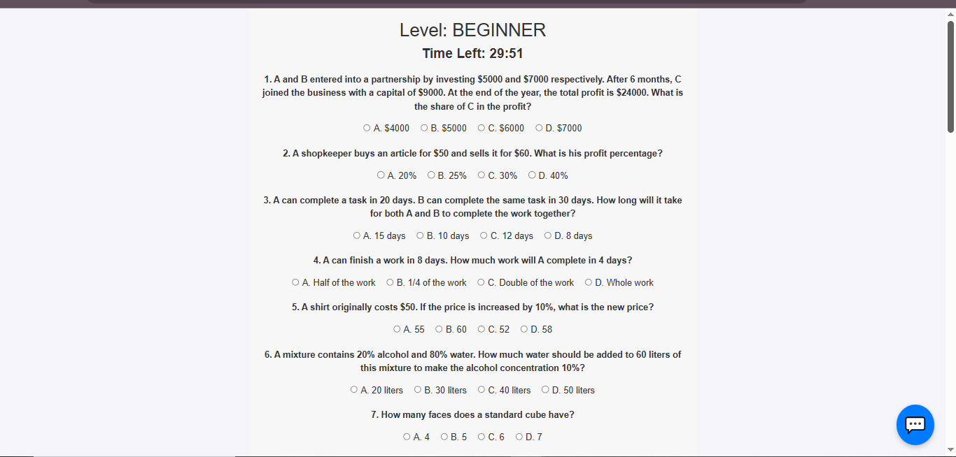
APTITUDE & PROBLEM SOLVING
🧠Timed aptitude quizzes with easy to hard levels to build reasoning skills
🧠Interactive problem-solving sessions covering arrays, trees, graphs, and recursion
🧠Detailed explanations and code examples for 400+ LeetCode-style problems
🧠Progress tracking to help users master data structures and algorithms

Slide 13
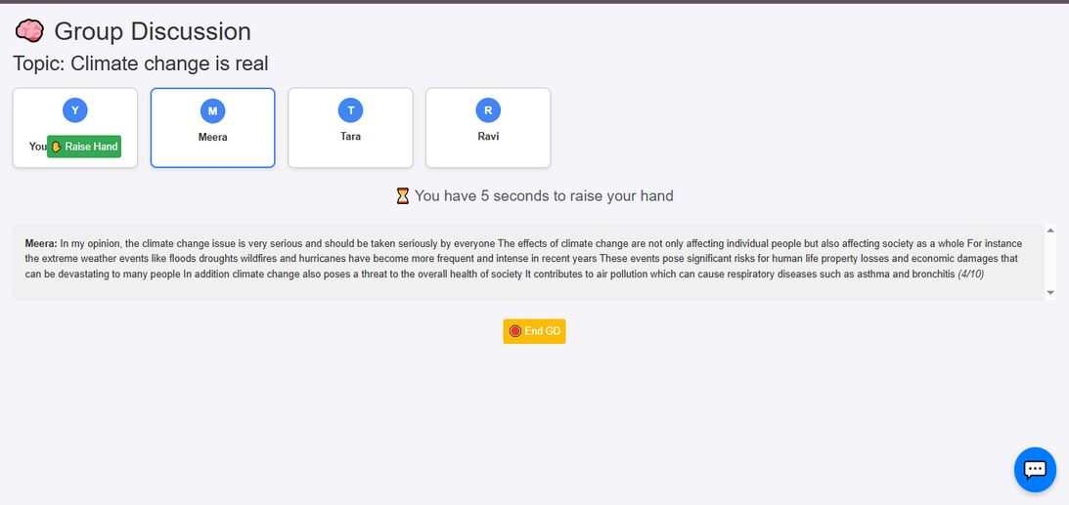
AI-POWERED GROUP DISCUSSIONS
🗣️Simulates real group discussion scenarios using AI-driven participants.
🗣️TinyLlama generates discussion questions and topics dynamically.
🗣️Turn-based interaction ensures balanced speaking opportunities and evaluates communication quality.
🗣️Frontend uses gTTS to speak AI responses and listens to user replies via voice input.

Slide 14
ROADMAP, NOTES & DISCUSSIONS
📝12-week structured learning roadmap covering core domains in Computer Science.
📝Practice assignments provided after each module to reinforce concepts.
📝Quick, easy-to-understand
handwritten and typed notes on key CS topics.
📝 Notes include Java, Python, OS, DBMS, CN, and DSA summaries.
📝 Integrateddiscussion hub for peer-to-peer Q&A and topic clarification.
📝Users can ask and answer questions,boosting collaborative learning.

Slide 15
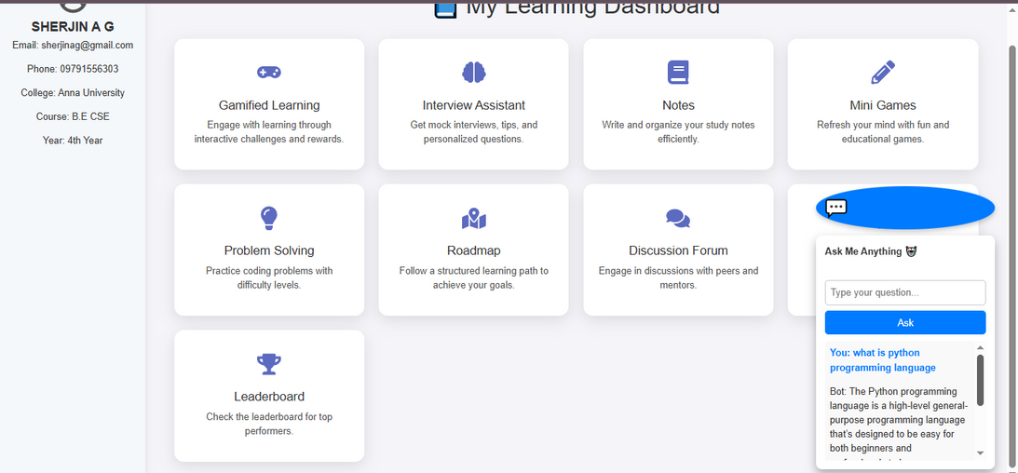
AI-POWERED CHATBOT
🤖Uses TinyLLaMA to understand and generate intelligent responses to student queries.
🤖Integrated on the frontend via text chat for course-related help and doubt-solving.
🤖Responds contextually using course material, past interactions, and user level.
🤖Offers personalized suggestions for videos, quizzes, and next steps in learning.

Slide 16
CONCLUSION & FUTURE SCOPE
🚀Launch mobile version for Android & iOS to expand accessibility.
🚀Integrate multilingual support for regional language users.
🚀Add learning analytics to monitor student progress in depth.
🚀 Improve personalized recommendations using AI.
🚀Upgrade to advanced TinyLLaMA models for better interaction.
🚀 Add real-time placement preparation modules and alerts.

Slide 17
THANK YOU

